Slide 1

Overview & Level Setting– Where we were
Limited test coverage
Many-one: Testers-to-Developer
Top Heavy Testing
2300 BDD tests
Minimal refactoring
Agile Maturity Level 1
Code first, test later mentality
Escaped sprint defect

Slide 2


Overview & Level Setting– Where we are
Testing Cupcake
Test Pyramid
UI
MANUAL
Service
Automated GUI Tests
Automated Integration
Tests
(API, Contracts, Component)
Automated Unit Tests
UNIT
Isn’t it ironic that the cupcake doesn’t have sprinkles
but the pyramid does?
2

Slide 3
Explore
E2E
Interface/API
Integration
Unit

Slide 4
Overview & Level Setting– Where we are
2016 - 2018
90% reduction in # tests
98% reduction in runtime
Multiple executions per day
4 attempts
2 dedicated staff to transition the test suite to Agile Teams

Slide 5
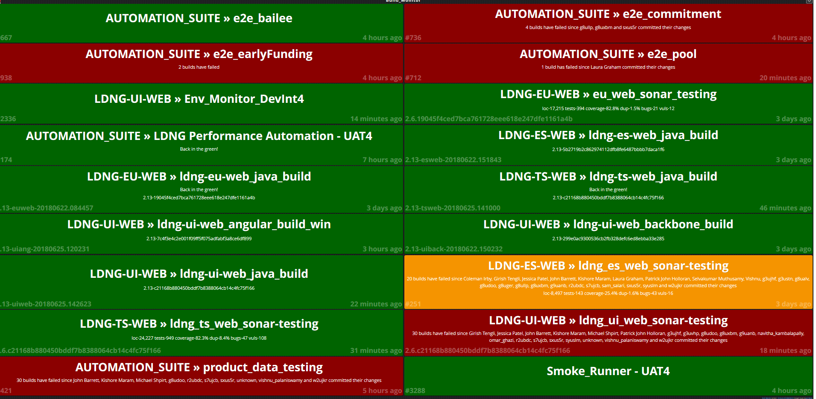

Overview & Level Setting– Where we are
24/7 Monitoring
Junit deployment pre-hook
Environment Shakeout Suite
Integration Testing
In-Sprint Performance Testing
Only In sprint exploratory – Level 4
BDD Context Driven Testing
Sonar and Metrics Checks
Runtime Product Based Testing
Failure Speaker Alarm/Emails

Slide 6
Test Pyramid – Integrate Upwards [minimize overlap]
Identify where tests go
Each layer should be independent and testing from a differing perspective
Each layer should be focusing on integration and not re-testing

Slide 7
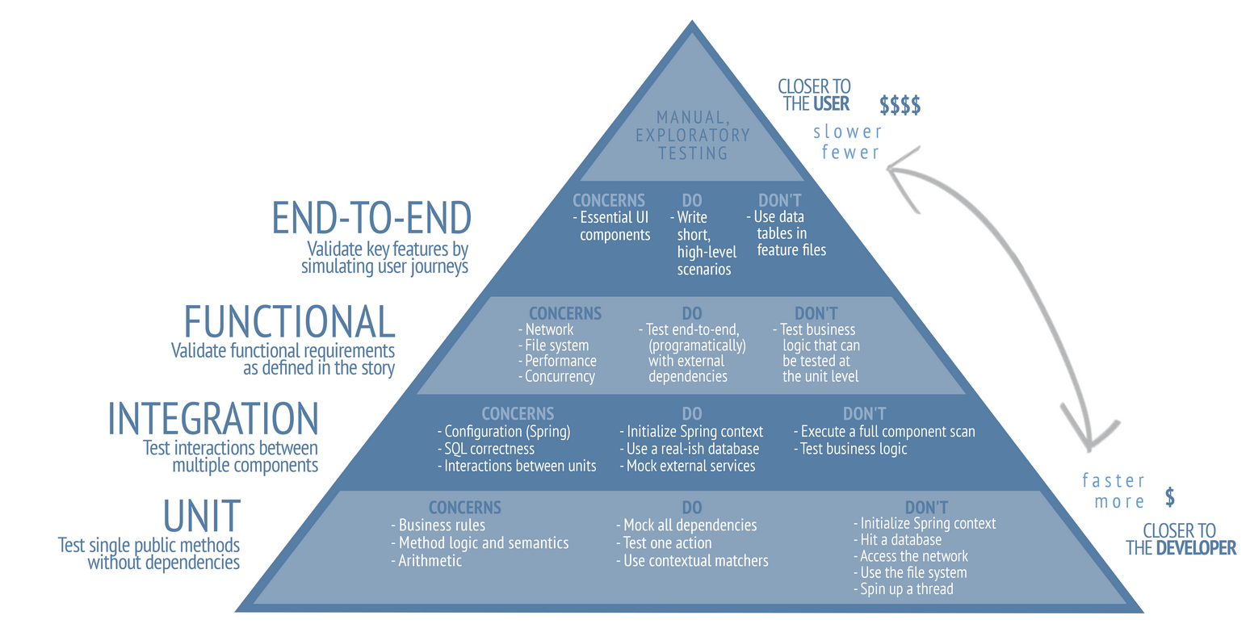
Test Pyramid – Java

Slide 8
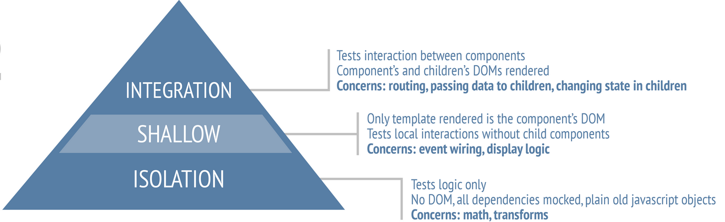
Test Pyramid – Browser

Slide 9
Code Quality
Test Framework
TDD
Test Design

Slide 10
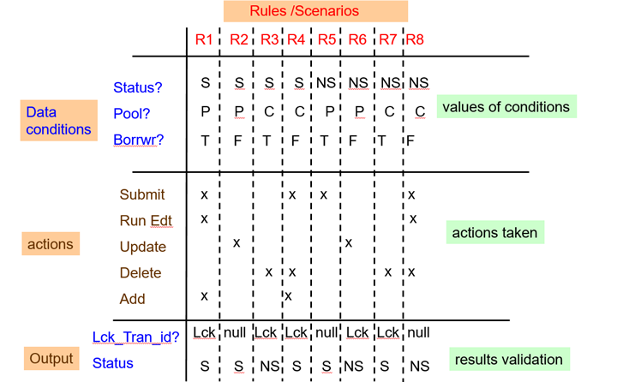
Test Design
Code Quality
Test Framework
TDD
Test Design Example:
Identify all data points/Entities
Identify all processes associated with flow
Identify expected output
Create all permutations
Validate and Optimize
Perform Team Test Reviews!!

Slide 11
Test Design
Code Quality
Test Framework
TDD
UNIT
Testing Technique Example:
Identify equivalence partitions
Identify boundaries

Slide 12
Test Design
Code Quality
Test Framework
TDD
UNIT
Mocks Repo
Data Repo/
Providers
Helpers / Pre/Post Setters
Utils / Common
TestNG
Junit5
PowerMock/
Mockito
Jasmine
Chai/Istanbul
Karma

Slide 13
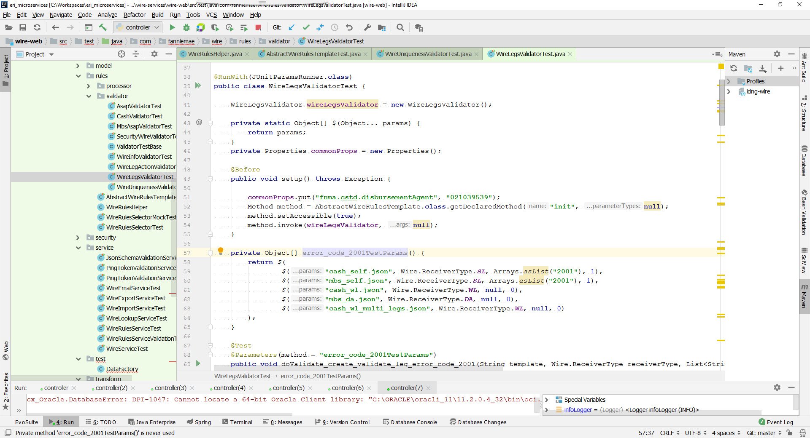
Test Design
Code Quality
Test Framework
TDD
UNIT

Slide 14
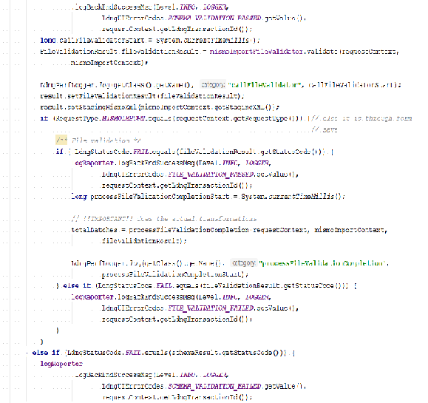
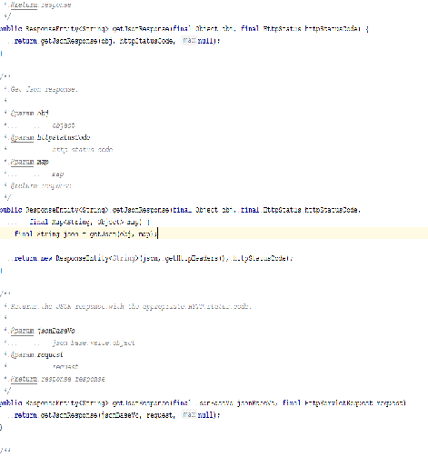
Test Design
Code Quality
Test Framework
TDD
UNIT
Assumption Based Programming
Modularized Code
Refactor on green only
Use constructor based injection instead of Auto-wiring resources directly
Hierarchal based coding
Level of granularity (debatable)

Slide 15
Test Design
Code Quality
Test Framework
TDD
UNIT
TDD
Requirement – Round Interest rate to 2 decimal places
Write - Test
Run - Fail
Write - Code
Run- Pass
Write – Code
Run - Pass
Break - Code
Run- Pass
Write- Test
Dev then Test
Requirement – Round Interest rate to 2 decimal places
Oh No! Test wasn’t testing what it should!!
Yikes! TDD
Anti Pattern
Refactor On Green
Requirement – Add 15 product
Use template pattern - Refactor
Run - Pass
Repeat
TDD
Notes:
Steps
1. Uncomment step 1 in MortgageCalcTDDTest
1. Uncomment step 1 in MortgageCalc and run tests = FAIL
2. Uncomment step 2 in MortgageCalc and rerun tests = PASS
4. Uncomment step 4 in MortgageCalc
5. Uncomment step 5 in MortgageCalcCodeFirstTest and run the test = PASS
6. Uncomment step 6 in MortgageCalcTDDTest and run the tests = FAIL
7. Uncomment step 7 in MortgageCalc and rerun tests in MortgageCalcTDDTest = PASS
8. Uncomment step 8 in _30yrMortgageCalcTDDTest and run tests = FAIL
9. Uncomment step 9 in _30yrMortgageCalc and run tests = PASS
10. Uncomment step 10 in _15yrMortgageCalc and run tests = PASS

Slide 16
Test Design
Code Quality
Test Framework
TDD
UNIT

Slide 17
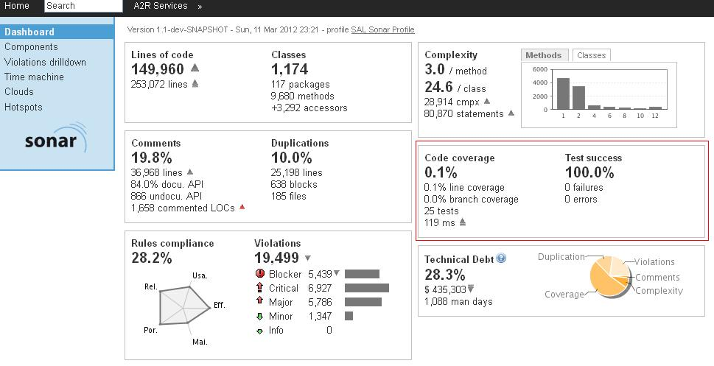
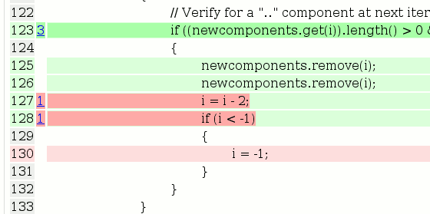
Test Design
Code Quality
Test Framework
TDD
UNIT
Quality build gates
Leverage tools for code coverage:
SonarCube (Left)
PIT – Mutation Testing (Bottom)
JaCoCo
ZAP
CLM

Slide 18
Integration
Application Container
Test Bed
Interface Mock / Injection
Transformer
Controllers
Common Utils
App
Validator
Service
DAO
Expected / Actual Repo
In Memory DB

Slide 19
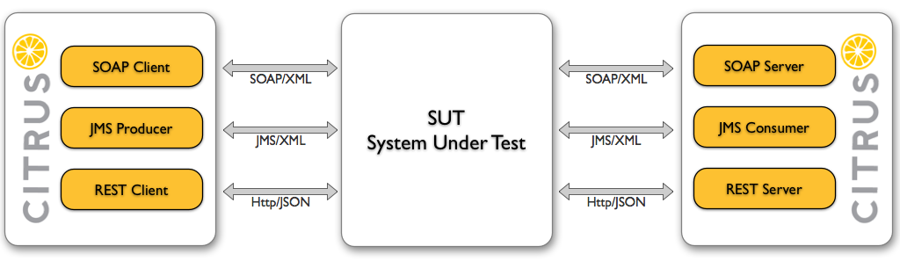
Integration

Slide 20
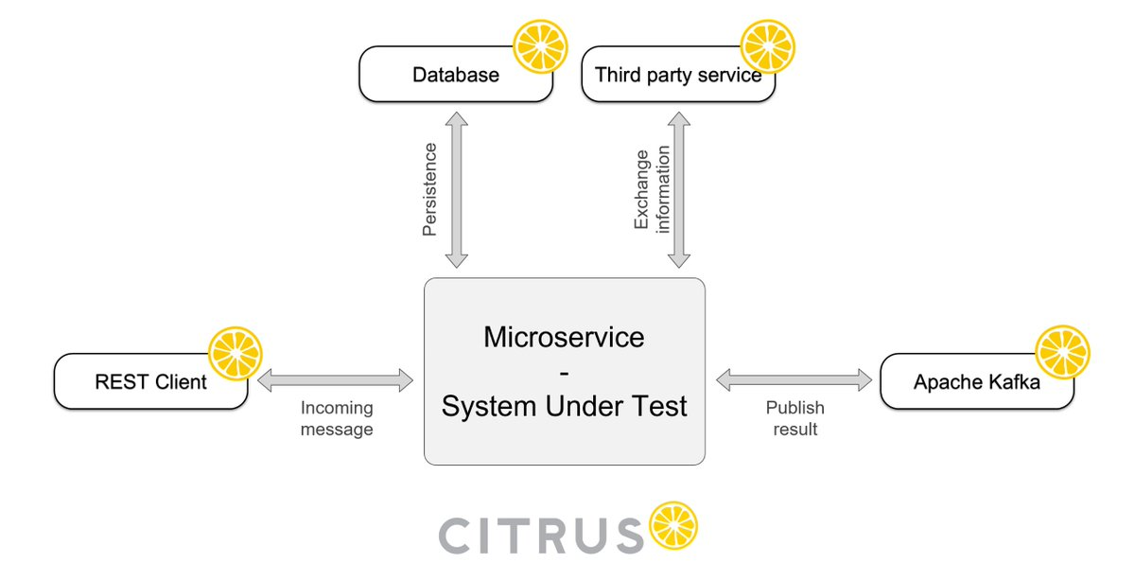
Integration

Slide 21
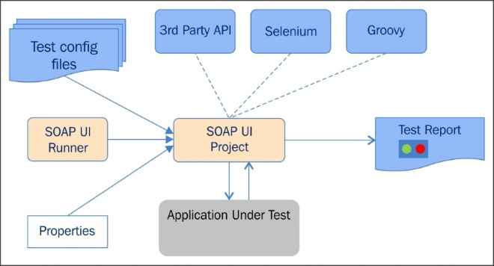
Interface / API

Slide 22
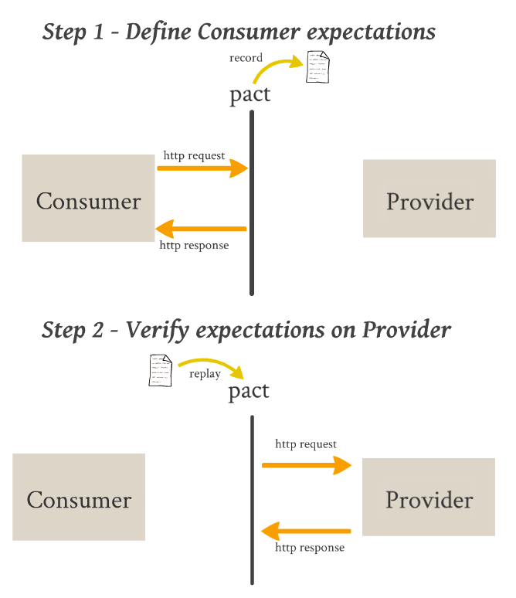
Interface / API

Slide 23
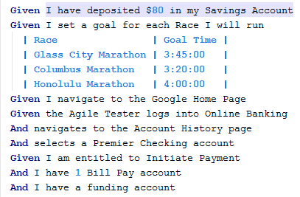
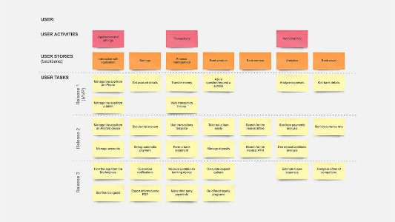
End-to-End
User
Interface
GlueCode
Selenium
GlueCode
Micro-Service
[Stub if unavailable]
SUT
Interfaces
Data Store

Slide 24
Exploratory
Museum Tour
Model Tour
Tourist Tour
Guided Tour
Chaotic Tour
Inspector Tour

